Slide 1
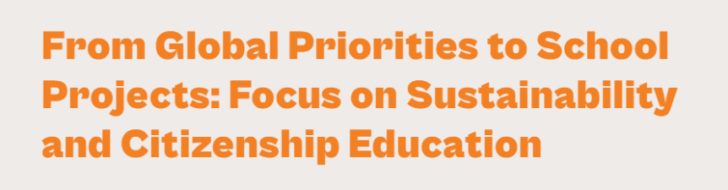
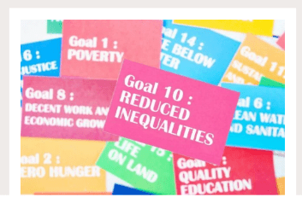
Berlin, Germany
1 December 2025 – 6 December 2025

Slide 2


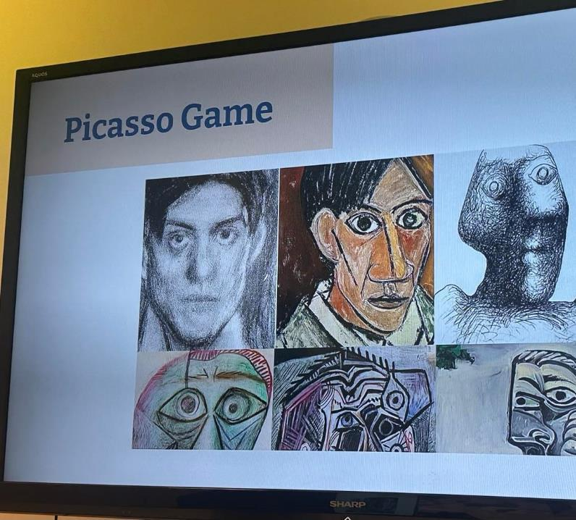



Ice-breaking activity

Slide 3
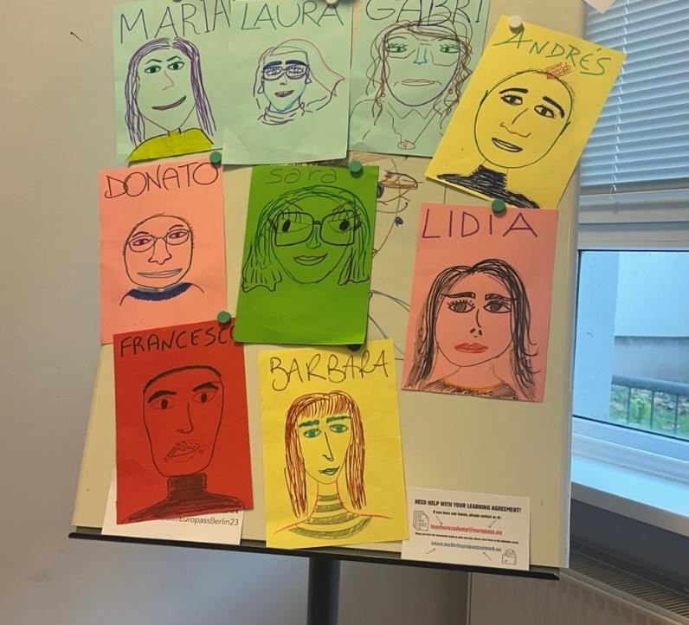
Ice-breaking activity

Slide 4
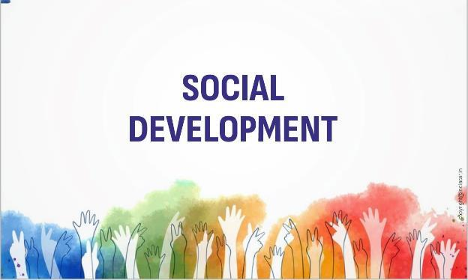
What is social development?
Economic development
Education
Health and well-being
Social Inclusion and Equity
Community development
Sustainable development
Democratic governance and Human rights
Social cohesion
Social Resilience

Slide 5
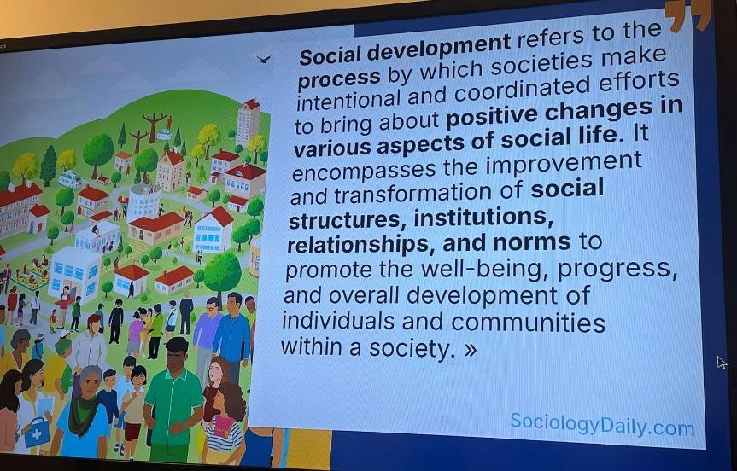
Social development refers to…

Slide 6
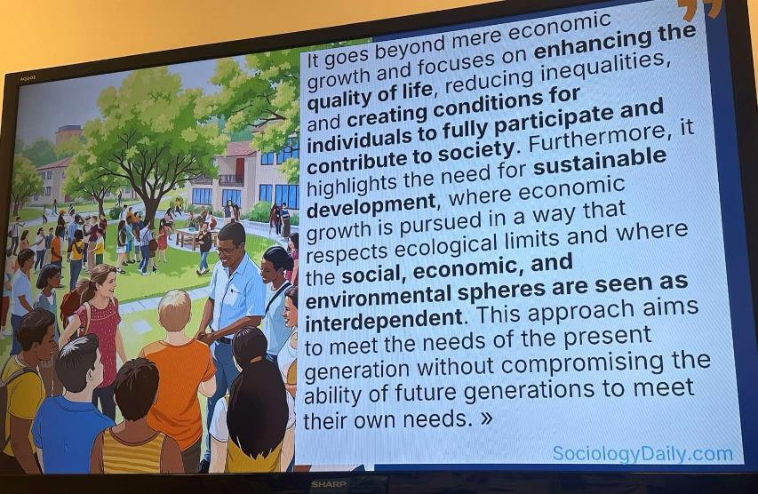
Social development goes beyond to...

Slide 7
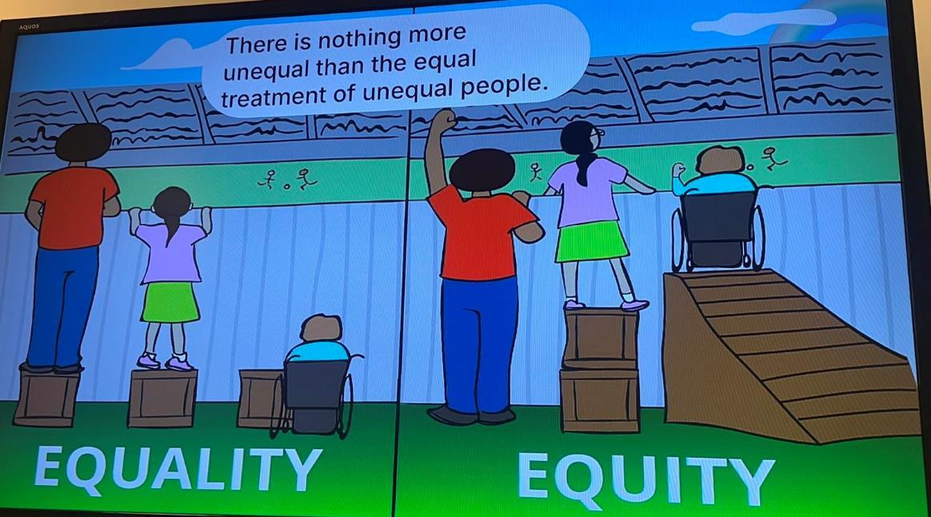

Slide 8
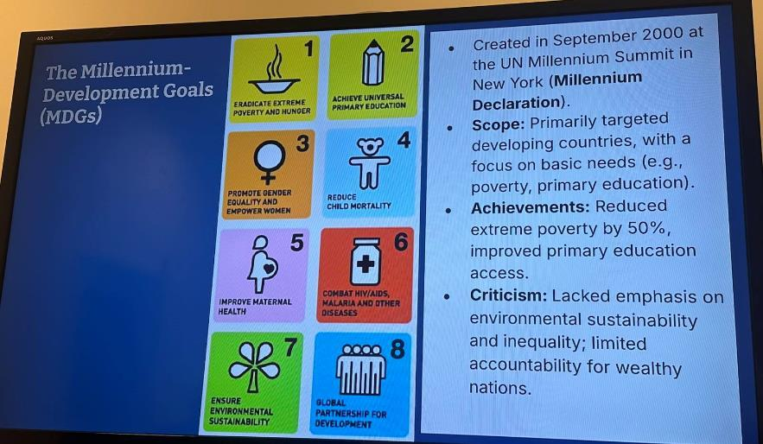
Sustainable Development Goals (SDG’s) Development

Slide 9
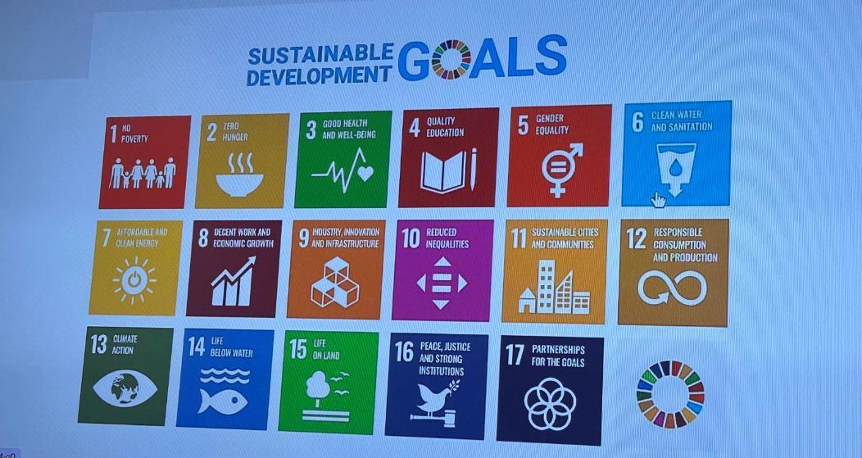
17 SDG’s GOALS

Slide 10
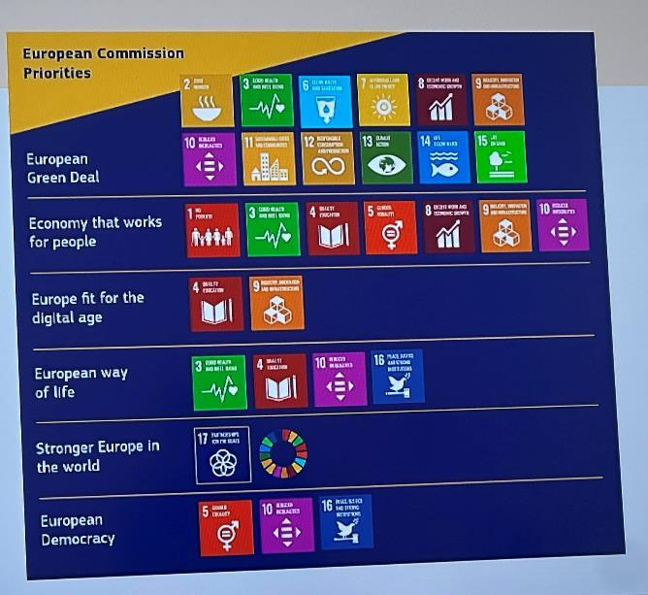
European Commission Priorities

Slide 11
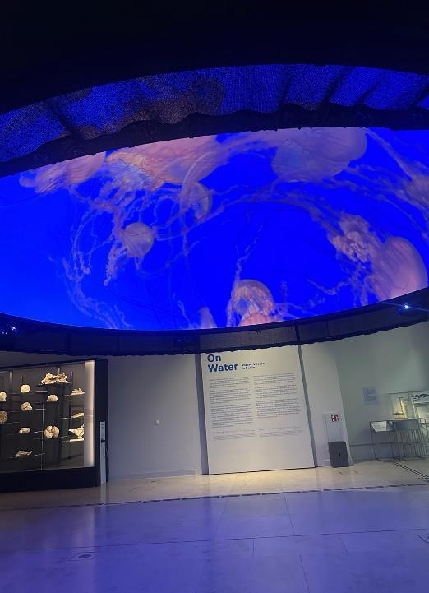
Humboldt Forum: Exhibition “On Water”
Water is life, but it can also destroy. The exhibition “On Water. WasserWissen in Berlin” will show current research projects of the Berlin University Alliance (BUA) on the topic of water from October 10, 2025 in the Humboldt Labor. These will be flanked by artistic positions that deal with the element of water and vividly convey its versatility.

Slide 12
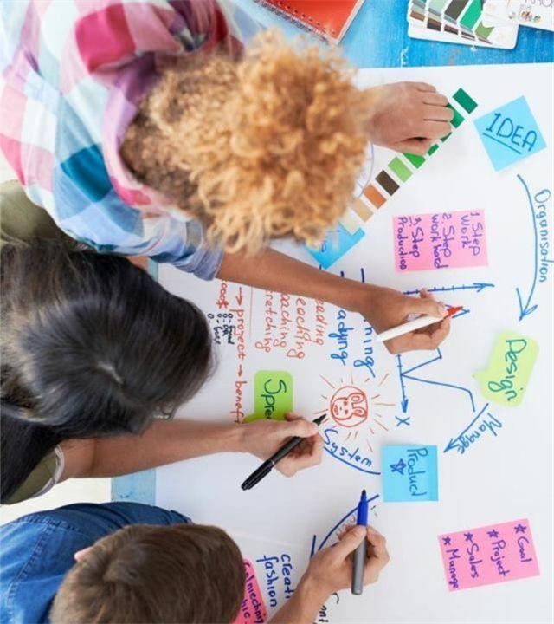
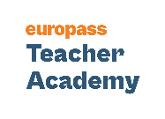
Project Based Learning in the Classroom:
Make Students’ Learning Real and Effective!

Slide 13
Traditional learning
Told what we need to know
Memorize
Problem assigned

Slide 14
Project Based Learning
Problem or challenge assigned
Need to know
Learn and apply to solve

Slide 15
VS
PROJECT
Occurs after learning
Lacks real-world context
It’s about the product
It’s teacher-directed
Can be done alone
All projects have the same goal
PROJECT BASED LEARNING
Learning occurs through the project
It’s based on real-world experiences or problems
It’s about the process
It’s student-directed
Requires collaboration and teacher guidance
Students have choice

Slide 16
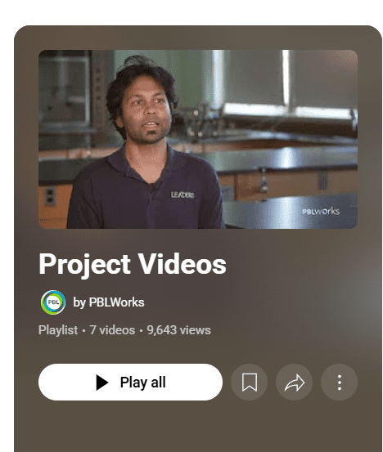
Let’s get inspired!

Slide 17
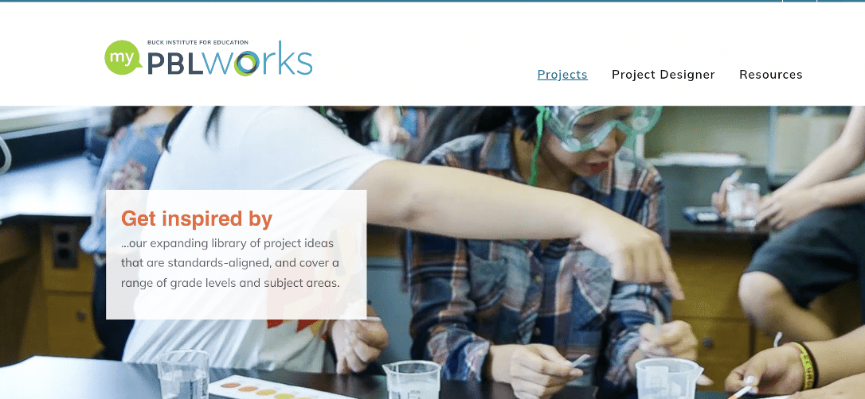
PROJECTS: https://my.pblworks.org/projects
RESOURCES: https://my.pblworks.org/resources?keywords=&f%5B0%5D=type%3A29

Slide 18
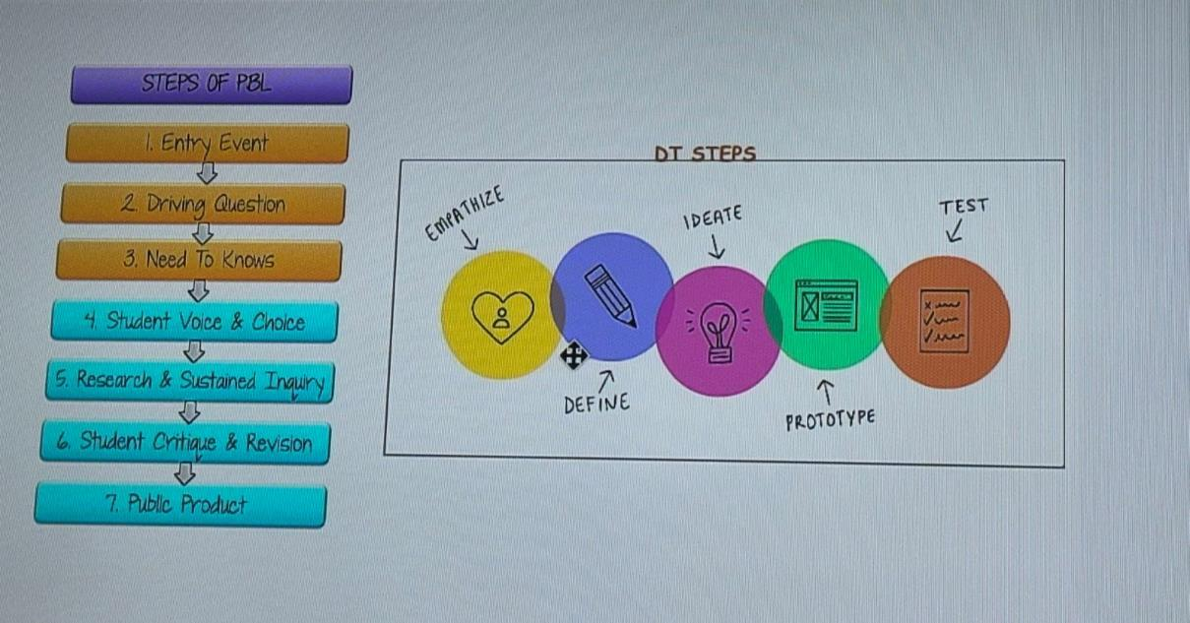

Slide 19
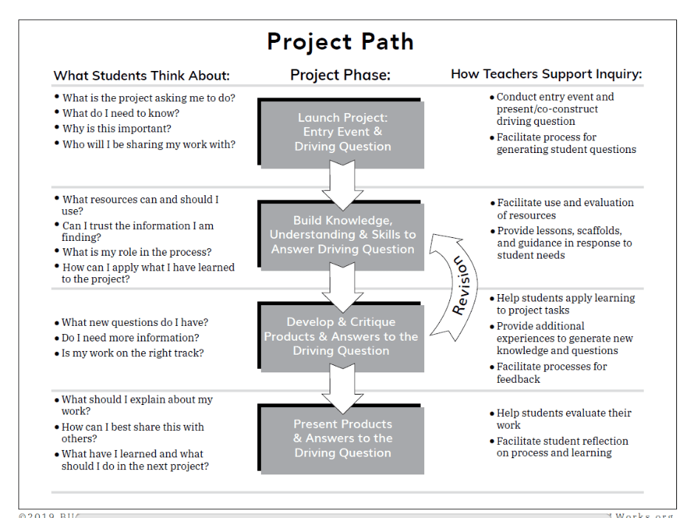

Slide 20
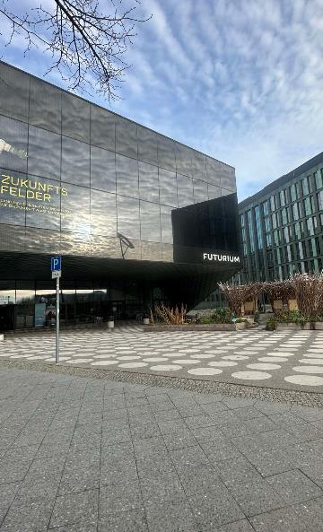
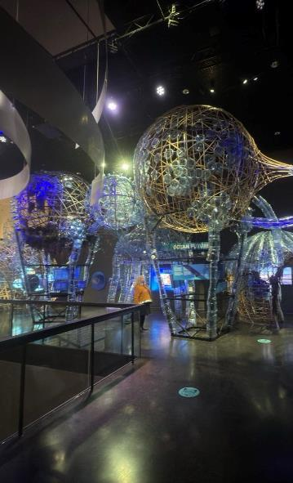
Futurium Museum
Here in the Futurium, everything revolves around the question: how do we want to live? In the exhibition, you can discover many possible futures; in the Forum, you can participate in open discussions; and, in the Futurium Lab, you can try out your own ideas.

Slide 21

Driving Questions
1. How can ______ improve _______?
How can studying flags improve our understanding of communities around the world?
2. How can _______ be applied to ________?
How can geometry skills be applied to cartography?
3. How can _______ change ________?
How can individuals change their communities?
4. How would you design a new _______?
How would you design a new school?
5. How does _________ affect/impact __________?
How does immigration affect communities around the world?
6. What impact did/does __________ have on ________?
What impact did humans have on the environment during the 20th century?
7. What makes a good/effective _________?
What makes an effective school?
8. How do/does __________ impact my community?
How does racism impact my community?
9. What would __________ be without __________?
What would our school be without classrooms?
10. If you were in charge of ____________, what would you change?
If you were in charge of our school, what would you change?

